Slide 1
Multiple Regression: A Model for the Mean
Structural vs. data-based Multicollinearity
Weighted regression
Nonlinear regression

Slide 2
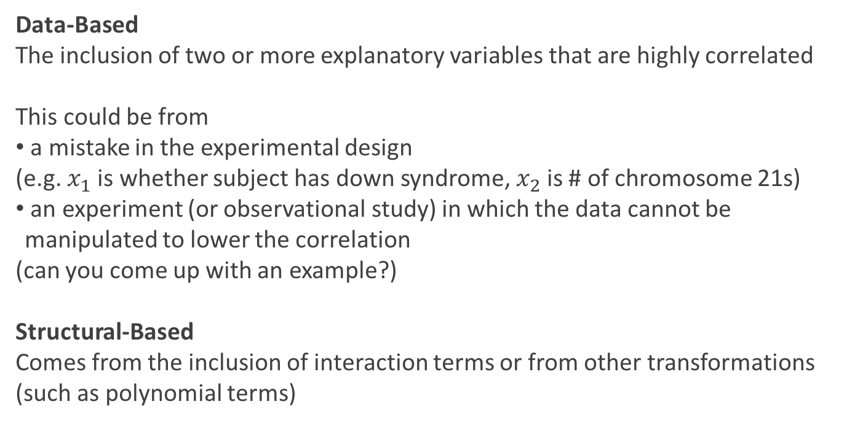
Types of Multicollinearity
Data-Based
The inclusion of two or more explanatory variables that are highly correlated
This could be from
a mistake in the experimental design
(e.g. $x_{1}$ is whether subject has down syndrome, $x_{2}$ is # of chromosome 21s)
an experiment (or observational study) in which the data cannot be manipulated to lower the correlation
(can you come up with an example?)
Structural-Based
Comes from the inclusion of interaction terms or from other transformations
(such as polynomial terms)

Slide 3
Data-Based Multicollinearity

Slide 4
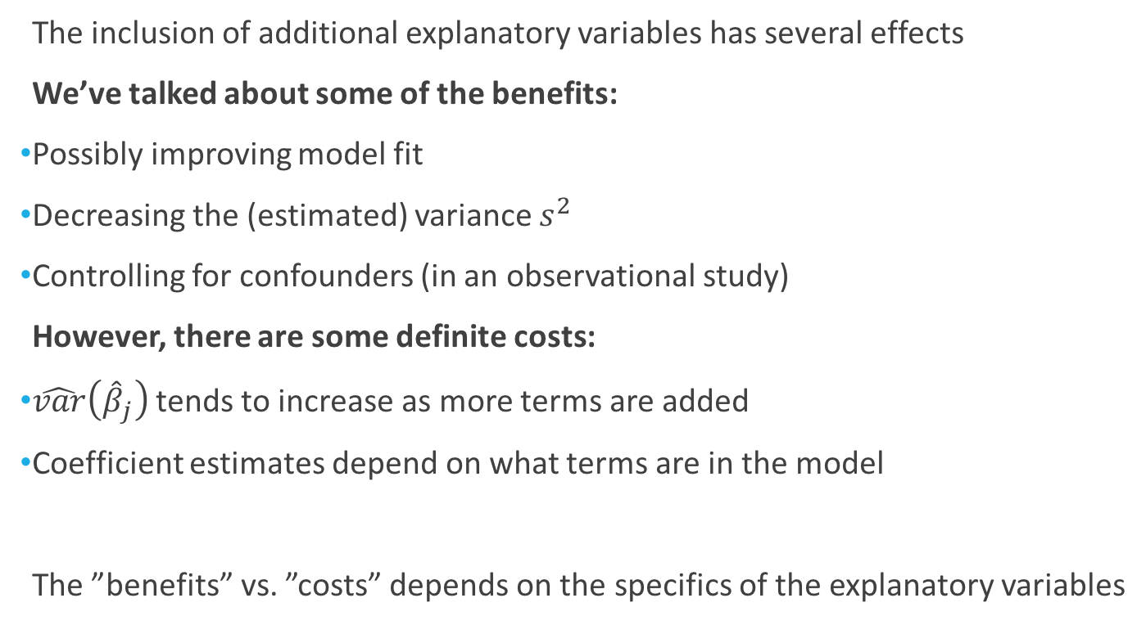
Data-Based Multicollinearity
The inclusion of additional explanatory variables has several effects
We’ve talked about some of the benefits:
Possibly improving model fit
Decreasing the (estimated) variance $s^{2}$
Controlling for confounders (in an observational study)
However, there are some definite costs:
$\hat{var}\left({\hat{β}}_{j}\right)$ tends to increase as more terms are added
Coefficient estimates depend on what terms are in the model
The ”benefits” vs. ”costs” depends on the specifics of the explanatory variables
“variance considerations”
“design considerations”

Slide 5
Variance Considerations

Slide 6
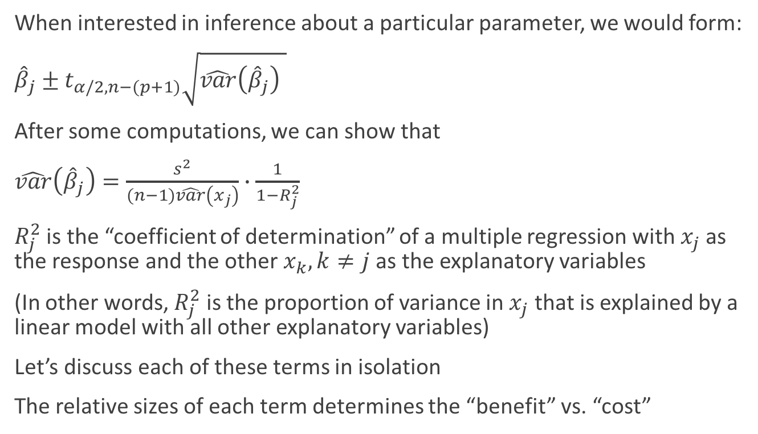
Variance Considerations
When interested in inference about a particular parameter, we would form:
${\hat{β}}_{j}±t_{α/2,n−(p+1)}\sqrt{\hat{var}\left({\hat{β}}_{j}\right) }$
After some computations, we can show that
$\hat{var}\left({\hat{β}}_{j}\right)=\frac{s^{2}}{(n−1)\hat{var}\left(x_{j}\right)}∙\frac{1}{1−R_{j}^{2}}$
$R_{j}^{2}$ is the “coefficient of determination” of a multiple regression with $x_{j}$ as the response and the other $x_{k}, k≠j$ as the explanatory variables
(In other words, $R_{j}^{2}$ is the proportion of variance in $x_{j}$ that is explained by a linear model with all other explanatory variables)
Let’s discuss each of these terms in isolation
The relative sizes of each term determines the “benefit” vs. “cost”

Slide 7
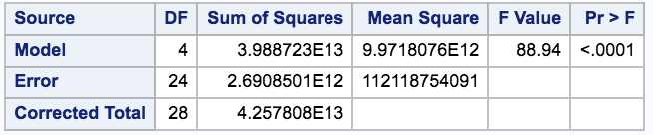
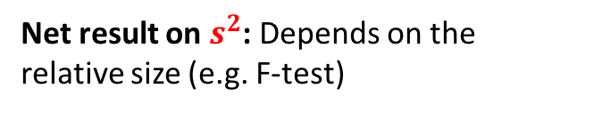
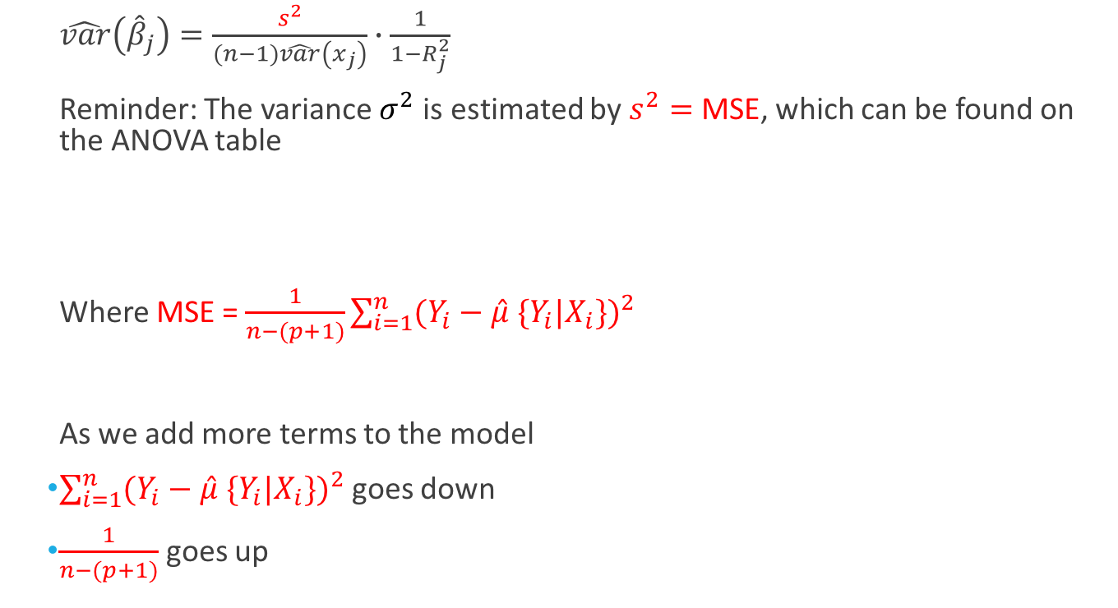
Variance Considerations
$\hat{var}\left({\hat{β}}_{j}\right)=\frac{s^{2}}{(n−1)\hat{var}\left(x_{j}\right)}∙\frac{1}{1−R_{j}^{2}}$
Reminder: The variance $σ^{2}$ is estimated by $s^{2}=$ MSE, which can be found on the ANOVA table
Where MSE = $\frac{1}{n−(p+1)}\sum_{i=1}^{n}{{(Y_{i}−\hat{μ} \{Y_{i}|X_{i}\})}^{2}}$
As we add more terms to the model
$\sum_{i=1}^{n}{{(Y_{i}−\hat{μ} \{Y_{i}|X_{i}\})}^{2}}$ goes down
$\frac{1}{n−(p+1)}$ goes up
Net result on $s^{2}$: Depends on the relative size (e.g. F-test)

Slide 8
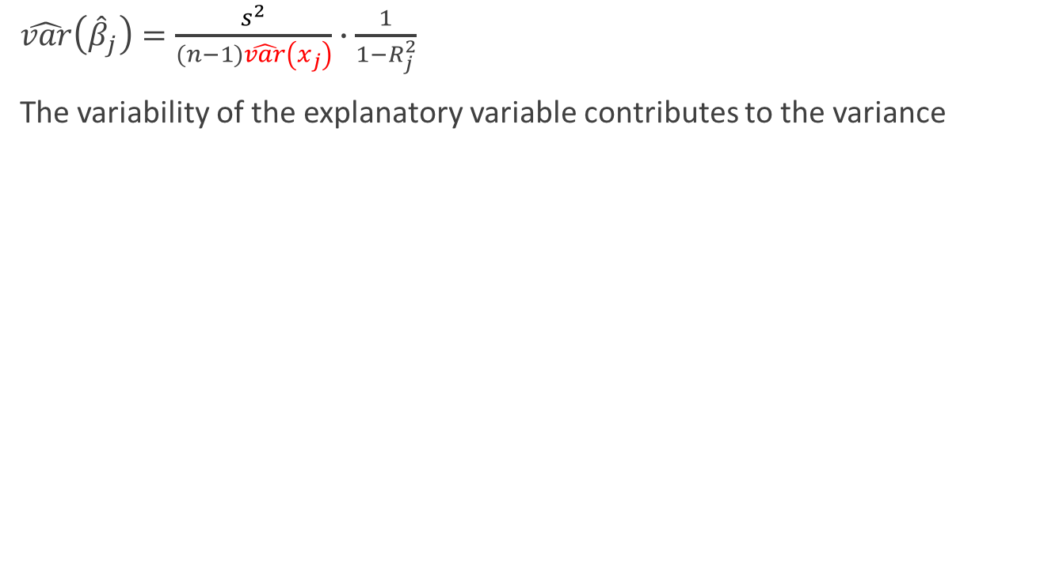
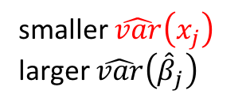
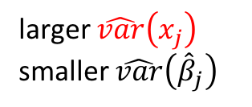
Variance Considerations
$\hat{var}\left({\hat{β}}_{j}\right)=\frac{s^{2}}{(n−1)\hat{var}\left(x_{j}\right)}∙\frac{1}{1−R_{j}^{2}}$
The variability of the explanatory variable contributes to the variance
smaller $\hat{var}\left(x_{j}\right)$
larger $\hat{var}\left({\hat{β}}_{j}\right)$
larger $\hat{var}\left(x_{j}\right)$
smaller $\hat{var}\left({\hat{β}}_{j}\right)$
8

Slide 9
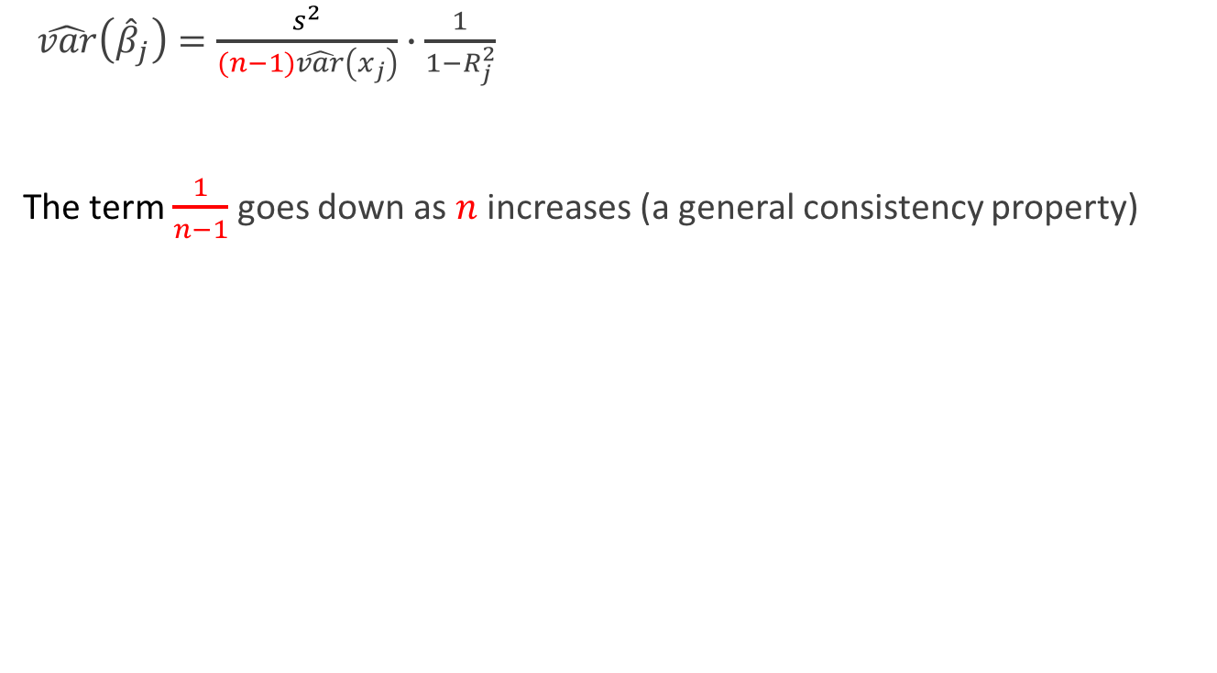
Variance Considerations
$\hat{var}\left({\hat{β}}_{j}\right)=\frac{s^{2}}{(n−1)\hat{var}\left(x_{j}\right)}∙\frac{1}{1−R_{j}^{2}}$
The term $\frac{1}{n−1}$ goes down as $n$ increases (a general consistency property)

Slide 10
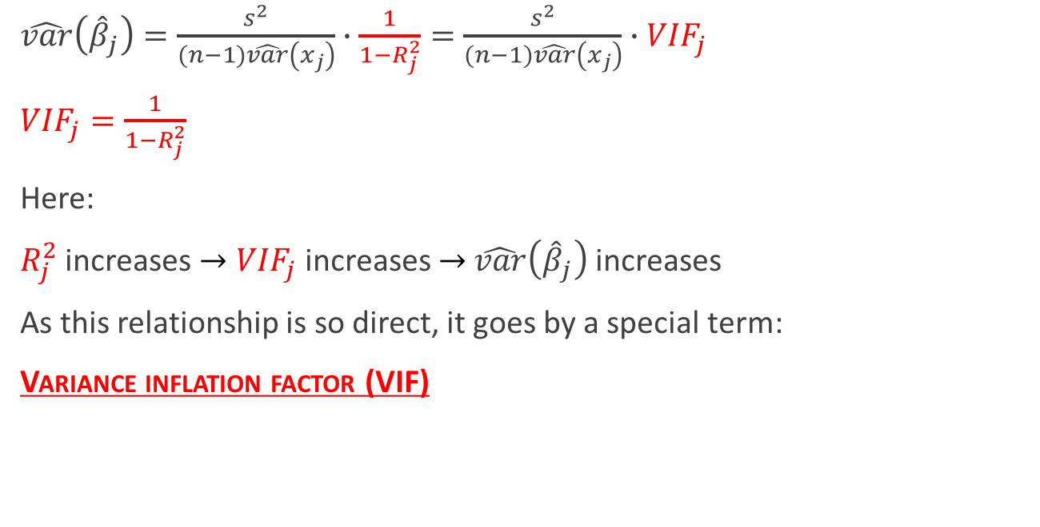
Variance Considerations
$\hat{var}\left({\hat{β}}_{j}\right)=\frac{s^{2}}{(n−1)\hat{var}\left(x_{j}\right)}∙\frac{1}{1−R_{j}^{2}}=\frac{s^{2}}{(n−1)\hat{var}\left(x_{j}\right)}∙{VIF}_{j}$
${VIF}_{j}=\frac{1}{1−R_{j}^{2}}$
Here:
$R_{j}^{2}$ increases $→{VIF}_{j}$ increases $→$ $\hat{var}\left({\hat{β}}_{j}\right)$ increases
As this relationship is so direct, it goes by a special term:
Variance inflation factor (VIF)

Slide 11
Design Considerations

Slide 12
Data-Based Multicollinearity
The inclusion of additional explanatory variables has several effects
We’ve talked about some of the benefits:
Possibly improving model fit
Decreasing the (estimated) variance $s^{2}$
Controlling for confounders (in an observational study)
However, there are some definite costs:
$\hat{var}\left({\hat{β}}_{j}\right)$ tends to increase as more terms are added
Coefficient estimates depend on what terms are in the model
The ”benefits” vs. ”costs” depends on the specifics of the explanatory variables
“design considerations”

Slide 13
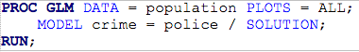
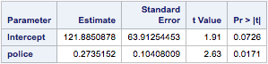
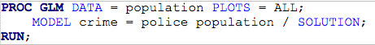
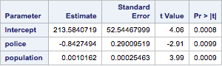
Design Considerations: Controlling for confounders
(From 9c_linearRegressionDarren)

Slide 14
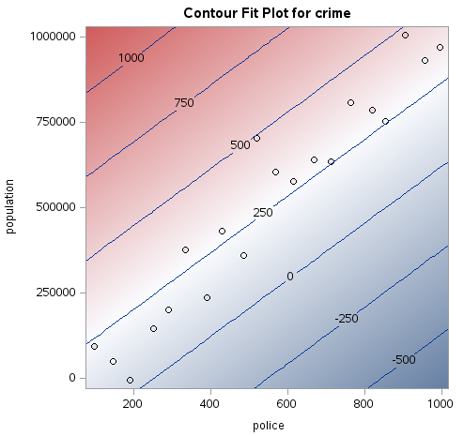
Design Considerations: Controlling for confounders
This is a “contour” plot.
Note: “Crime” is not plotted here
(Decreasing fitted values)
(From 9c_linearRegressionDarren)

Slide 15
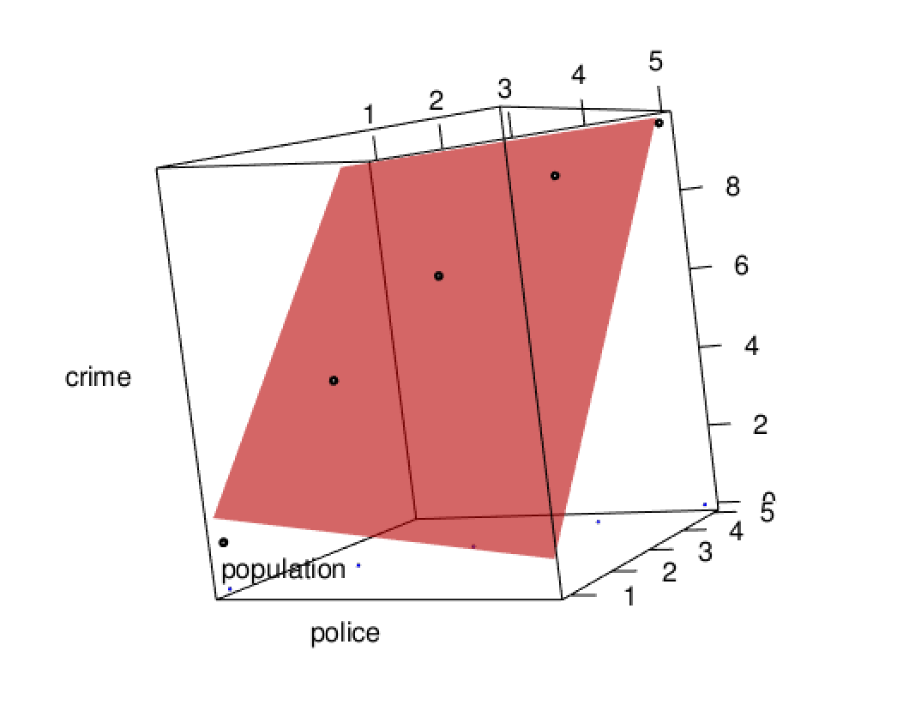
Go to Visualization…
In-class experiment with code:
12a_regressionInvestigation.R

Slide 16
Design Considerations: Experimental Design
A big initiative in classical experimental design was to create designs that are orthogonal
With an orthogonal design, each of the explanatory variables are uncorrelated
This has (had) some benefits
(estimation is computationally easier and more stable)
The coefficient estimates for an explanatory variable is the same whether or not other explanatory variables are included
The sums of squares are maximally reduced

Slide 17
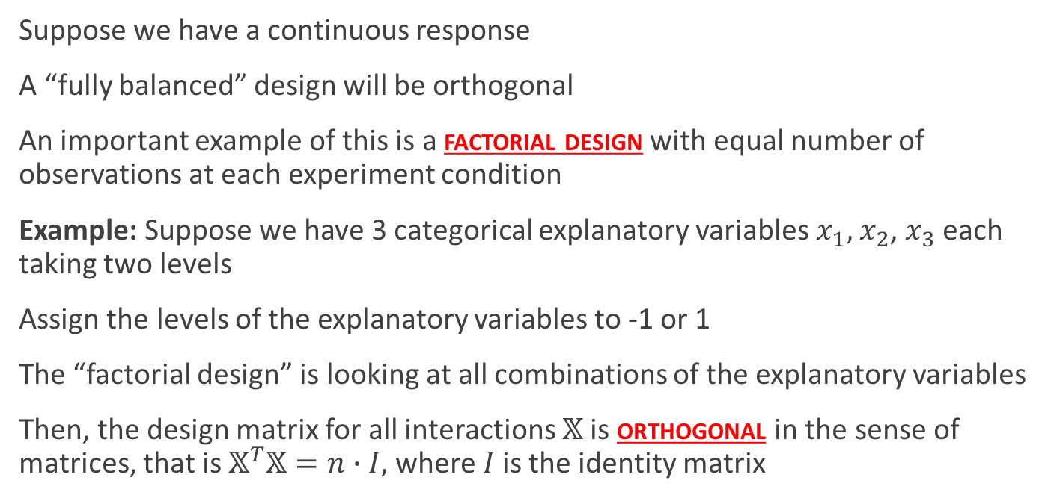
Example of Orthogonal Design
Suppose we have a continuous response
A “fully balanced” design will be orthogonal
An important example of this is a factorial design with equal number of observations at each experiment condition
Example: Suppose we have 3 categorical explanatory variables $x_{1},$ $x_{2}$, $x_{3}$ each taking two levels
Assign the levels of the explanatory variables to -1 or 1
The “factorial design” is looking at all combinations of the explanatory variables
Then, the design matrix for all interactions $𝕏$ is orthogonal in the sense of matrices, that is $𝕏^{T}𝕏=n∙I,$ where $I$ is the identity matrix

Slide 18
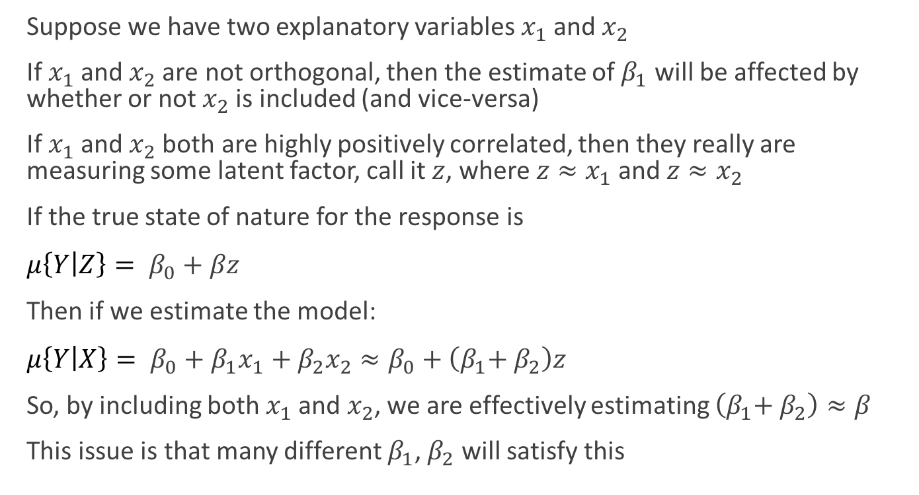
Design Considerations: Observational Studies
Suppose we have two explanatory variables $x_{1}$ and $x_{2}$
If $x_{1}$ and $x_{2}$ are not orthogonal, then the estimate of $β_{1}$ will be affected by whether or not $x_{2}$ is included (and vice-versa)
If $x_{1}$ and $x_{2}$ both are highly positively correlated, then they really are measuring some latent factor, call it $z$, where $z≈x_{1}$ and $z≈x_{2}$
If the true state of nature for the response is
$μ\left\{Y | Z\right\}= β_{0}+βz$
Then if we estimate the model:
$μ\left\{Y | X\right\}= β_{0}+{β_{1}x}_{1} \text{+ }β_{2}x_{2}≈β_{0}+\left(β_{1}\text{+ }β_{2}\right)z$
So, by including both $x_{1}$ and $x_{2}$, we are effectively estimating $\left(β_{1}\text{+ }β_{2}\right)≈β$
This issue is that many different $β_{1}$, $β_{2}$ will satisfy this

Slide 19
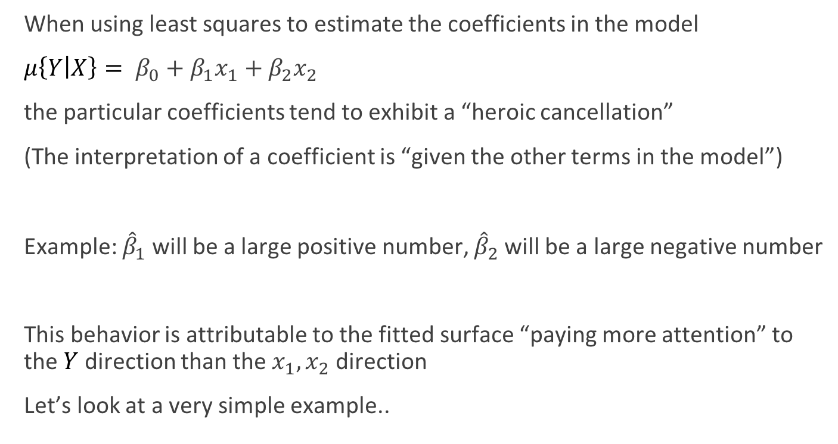
Design Considerations: Observational Studies
When using least squares to estimate the coefficients in the model
$μ\left\{Y | X\right\}= β_{0}+{β_{1}x}_{1} \text{+ }β_{2}x_{2}$
the particular coefficients tend to exhibit a “heroic cancellation”
(The interpretation of a coefficient is “given the other terms in the model”)
Example: ${\hat{β}}_{1}$ will be a large positive number, ${\hat{β}}_{2}$ will be a large negative number
This behavior is attributable to the fitted surface “paying more attention” to the $Y$ direction than the $x_{1}, x_{2}$ direction
Let’s look at a very simple example..

Slide 20
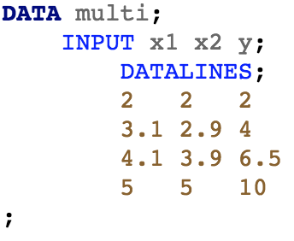
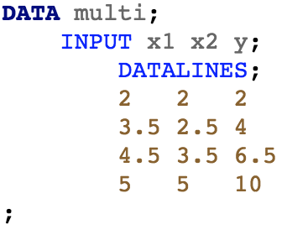
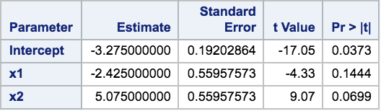
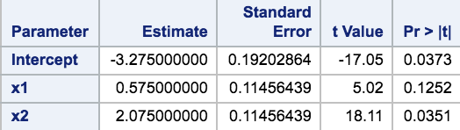
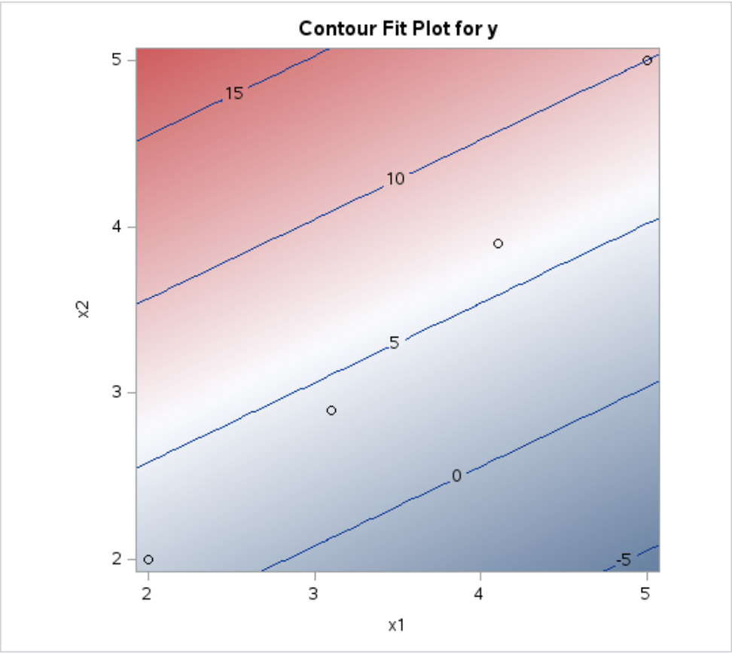
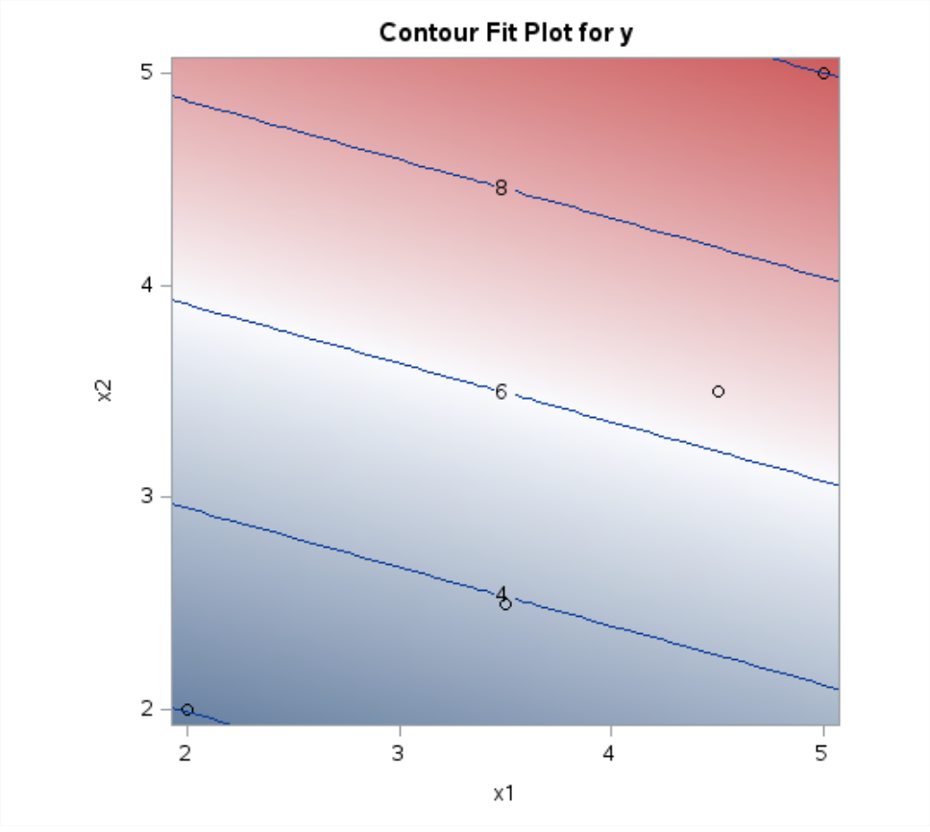
(Decreasing fitted values)
(Increasing fitted values)

Slide 21
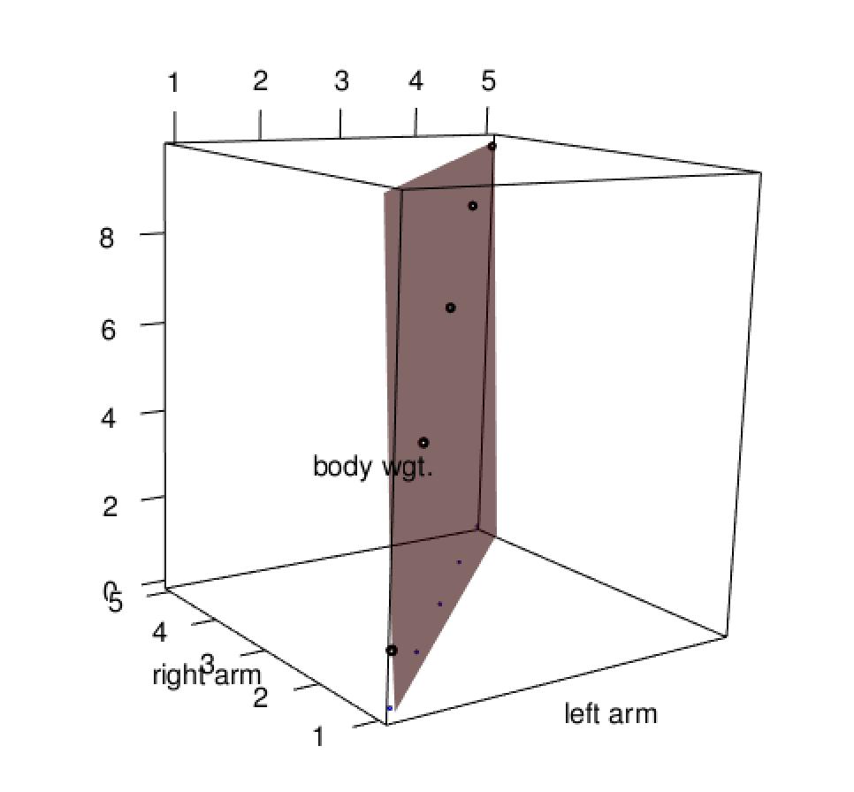
Go to Visualization…
In-class experiment with code:
12a_regressionInvestigation.R

Slide 22
Multicollinearity & Predictions

Slide 23
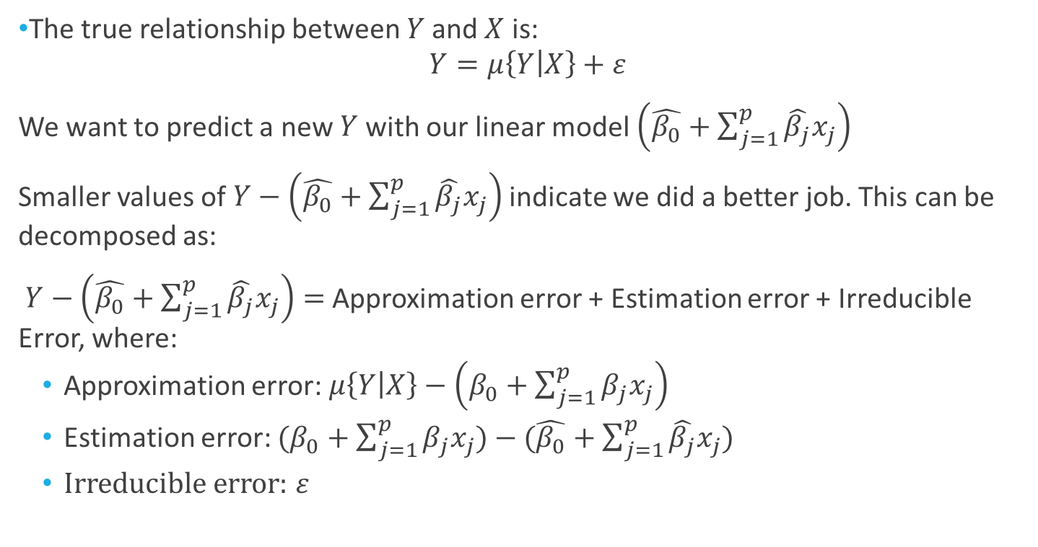
Back to Decomposing the Prediction Accuracy
The true relationship between $Y$ and $X$ is:
$$Y=μ\left\{Y | X\right\}+ε$$
We want to predict a new $Y$ with our linear model $\left(\hat{β_{0}}+\sum_{j=1}^{p}{\hat{β_{j}}x_{j}}\right)$
Smaller values of $Y−\left(\hat{β_{0}}+\sum_{j=1}^{p}{\hat{β_{j}}x_{j}}\right)$ indicate we did a better job. This can be decomposed as:
$Y−\left(\hat{β_{0}}+\sum_{j=1}^{p}{\hat{β_{j}}x_{j}}\right)=$ Approximation error + Estimation error + Irreducible Error, where:
Approximation error: $μ\left\{Y | X\right\}−\left(β_{0}+\sum_{j=1}^{p}{β_{j}x_{j}}\right)$
Estimation error: $(β_{0}+\sum_{j=1}^{p}{β_{j}x_{j}})−(\hat{β_{0}}+\sum_{j=1}^{p}{\hat{β_{j}}x_{j}})$
Irreducible error: $ε$

Slide 24
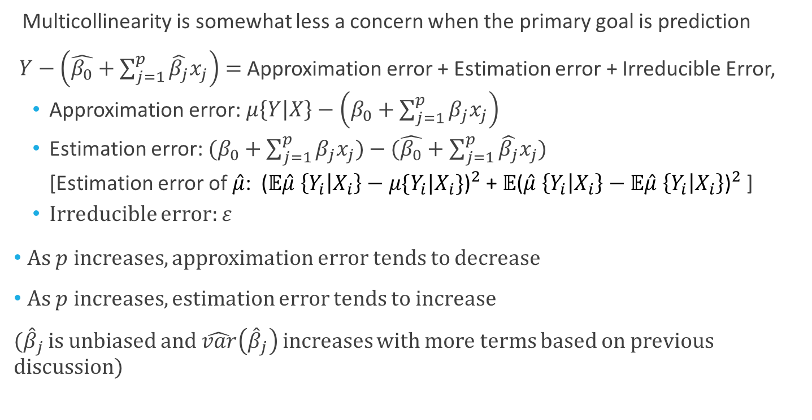
Multicollinearity and Predictions
Multicollinearity is somewhat less a concern when the primary goal is prediction
$Y−\left(\hat{β_{0}}+\sum_{j=1}^{p}{\hat{β_{j}}x_{j}}\right)=$ Approximation error + Estimation error + Irreducible Error,
Approximation error: $μ\left\{Y | X\right\}−\left(β_{0}+\sum_{j=1}^{p}{β_{j}x_{j}}\right)$
Estimation error: $(β_{0}+\sum_{j=1}^{p}{β_{j}x_{j}})−(\hat{β_{0}}+\sum_{j=1}^{p}{\hat{β_{j}}x_{j}})$
[Estimation error of $\hat{μ}$: ${\text{(}𝔼\hat{μ} \left\{Y_{i} | X_{i}\right\}−μ\{Y_{i}|X_{i}\}\text{)}}^{2}$ + $𝔼{\text{(}\hat{μ} \left\{Y_{i} | X_{i}\right\}−𝔼\hat{μ} \left\{Y_{i} | X_{i}\right\}\text{)}}^{2}$ ]
Irreducible error: $ε$
As $p$ increases, approximation error tends to decrease
As $p$ increases, estimation error tends to increase
(${\hat{β}}_{j}$ is unbiased and $\hat{var}\left({\hat{β}}_{j}\right)$ increases with more terms based on previous discussion)

Slide 25
Example: Kleiber’s Law

Slide 26
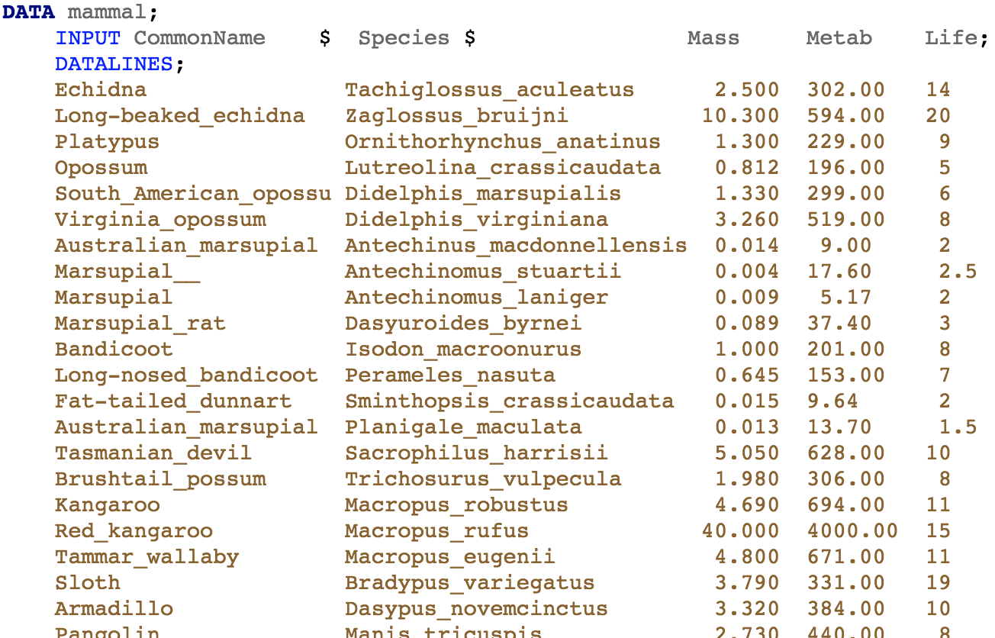
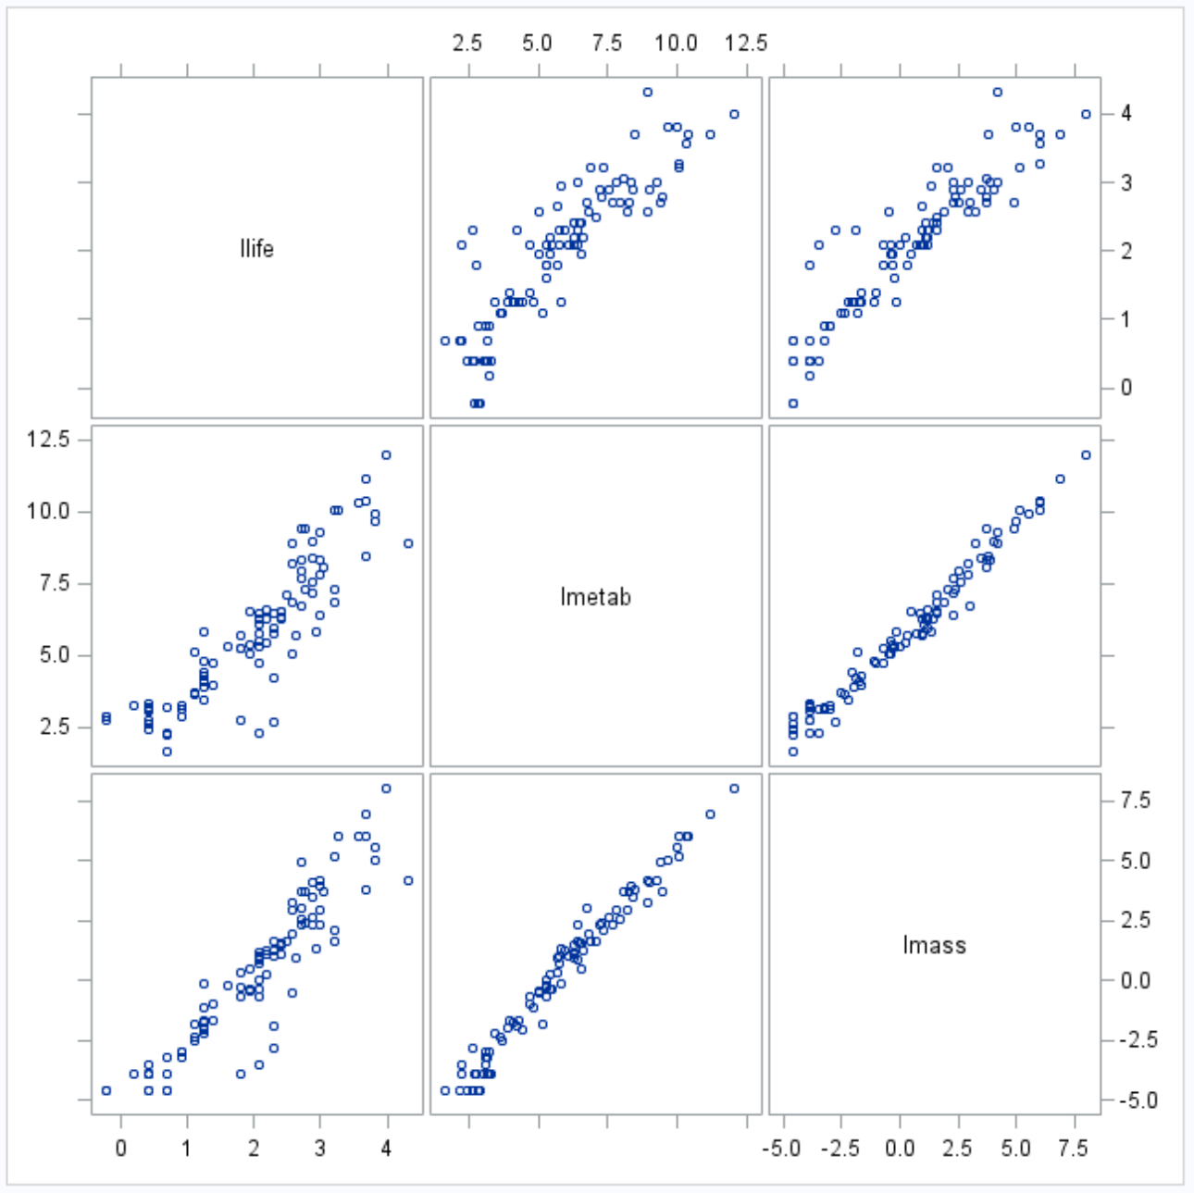
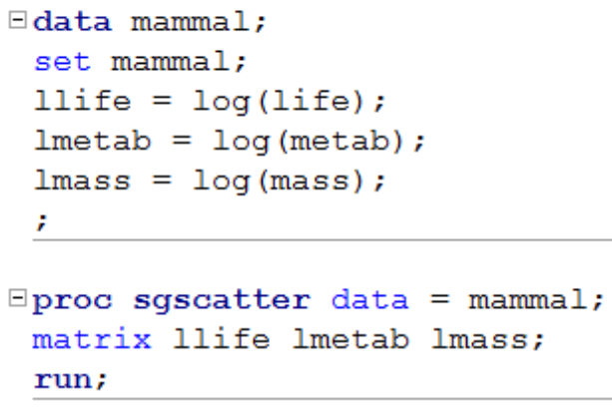
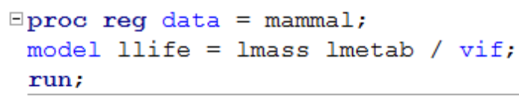
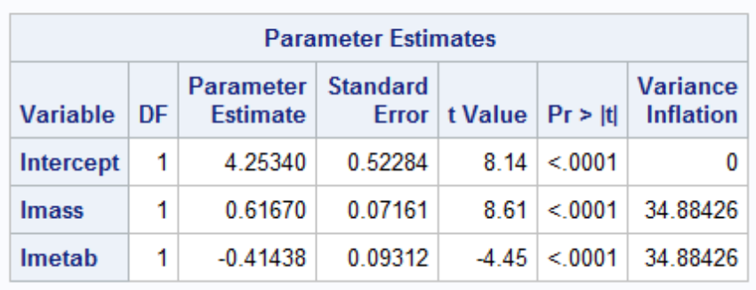
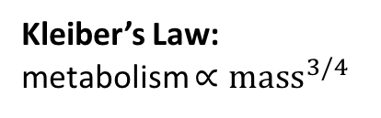
Example: Kleiber’s Law
What is a pangolin? Why is it notable?
Kleiber’s Law: metabolism $∝{mass}^{3/4}$
(Note: Using PROC CORR you can create the correlation matrix among all the explanatory variables)

Slide 27
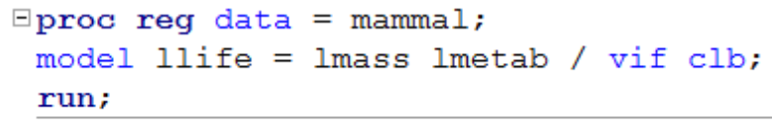
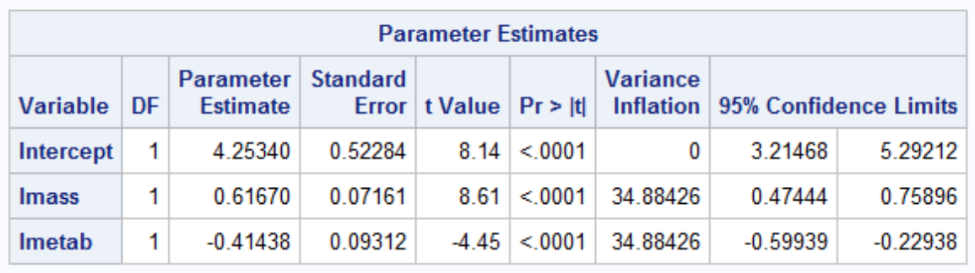
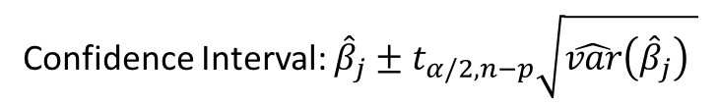
Confidence Intervals for Coefficients
Confidence Interval: ${\hat{β}}_{j}±t_{α/2,n−p}\sqrt{\hat{var}\left({\hat{β}}_{j}\right) }$

Slide 28
Possible Remediation
It is provably impossible in an observational study to use only the data to decide whether you should use mass or metabolism
The inclusion of both will lead to a nonsensical inference
What is really happening is that both mass and metabolism seem to be different aspects of the same underlying quantity (total # of cells)
As this quantity wasn’t directly measured, it is called it a latent factor
We can do one of the following:
Use subject matter expertise to choose which explanatory variable to use
Use something like principal components to estimate the latent factor
(or even more simply use a particular linear combination)
Use ‘ridge’ regression to constrain estimates to prevent heroic cancellation

Slide 29
Structural-Based Multicollinearity

Slide 30
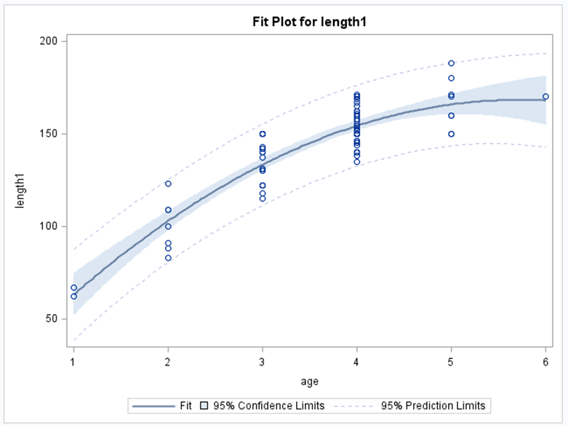

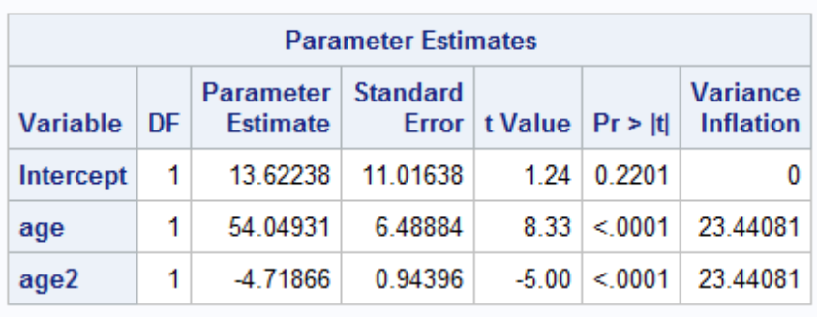
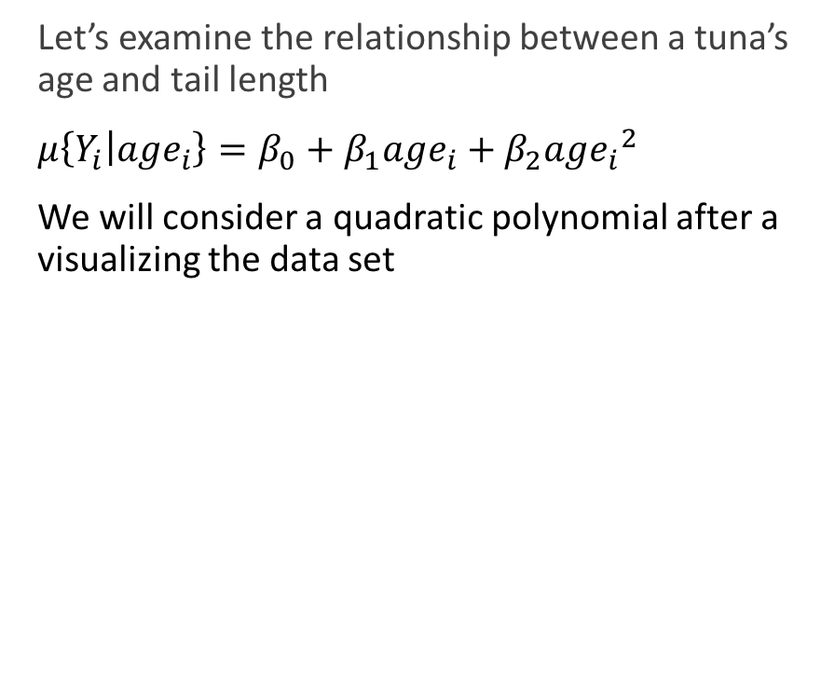
Structural-Based Multicollinearity
Let’s examine the relationship between a tuna’s age and tail length
$μ\left\{Y_{i} | {age}_{i}\right\}=β_{0}+{β_{1}age}_{i}+β_{2}{{age}_{i}}^{2}$
We will consider a quadratic polynomial after a visualizing the data set

Slide 31
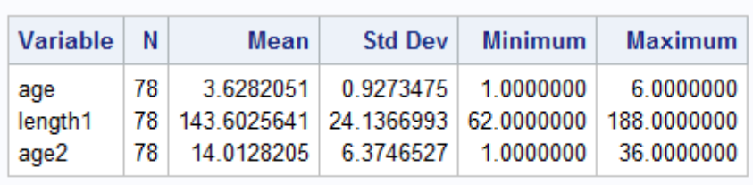
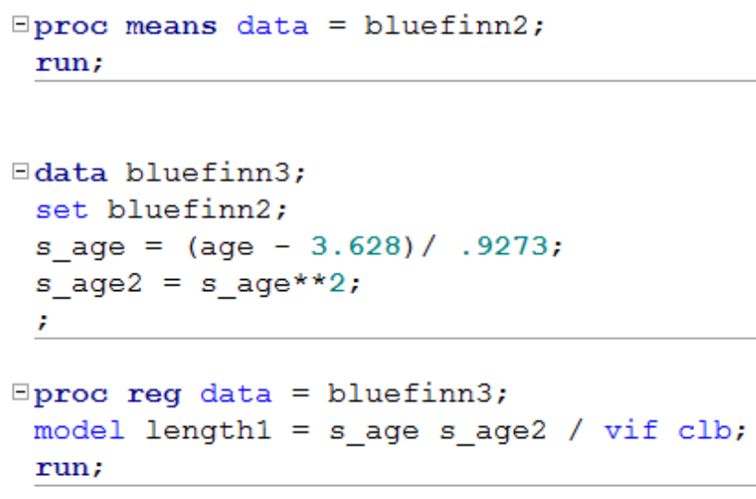

Structural-Based Multicollinearity
As large VIFs increase the standard errors, it would be beneficial to decrease them
One solution is via standardization
Before standardization
After standardization
Downside:
Interpretation is now in “standard deviations away from the mean of age” instead of years

Slide 32
Conclusion
Multicollinearity is a term that describes the linear correlation between explanatory variables.
Multicollinearity can have the effect of inflating the variance of the estimate. This has the effect having less confidence in the value of the estimate through wider confidence intervals. It will also inflate the p-values and make your tests less powerful.
The variance inflation factor (VIF) is a common measure of multicollinearity. (tolerance is another and is equal to 1/VIF)
There are two types of collinearity: data based and structural.
Methods of dealing with multicollinearity include deleting redundant variables and/or designing a better experiment. If the multicollinearity is structural then centering / standardizing the variables may help.

Slide 33
Weighted Regression

Slide 34
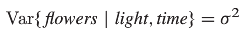
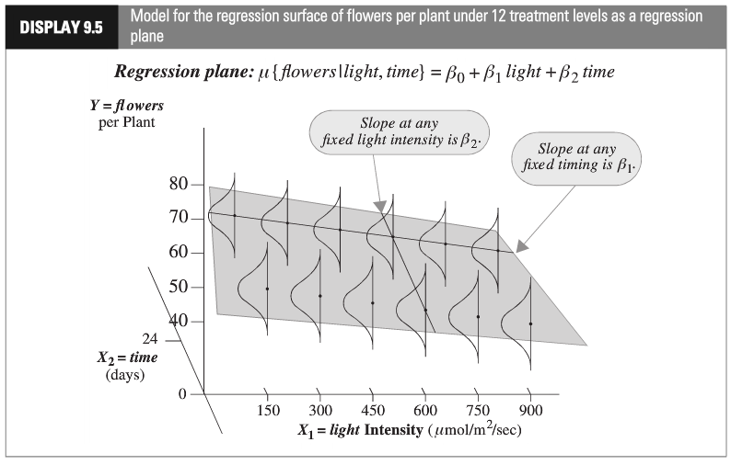
Multiple Regression: Constant Variance
“Constant Variance Assumption”
(homoscedasticity)
This assumption is needed for the inferential tools developed in the next Chapter (intervals, tests, etc.)

Slide 35
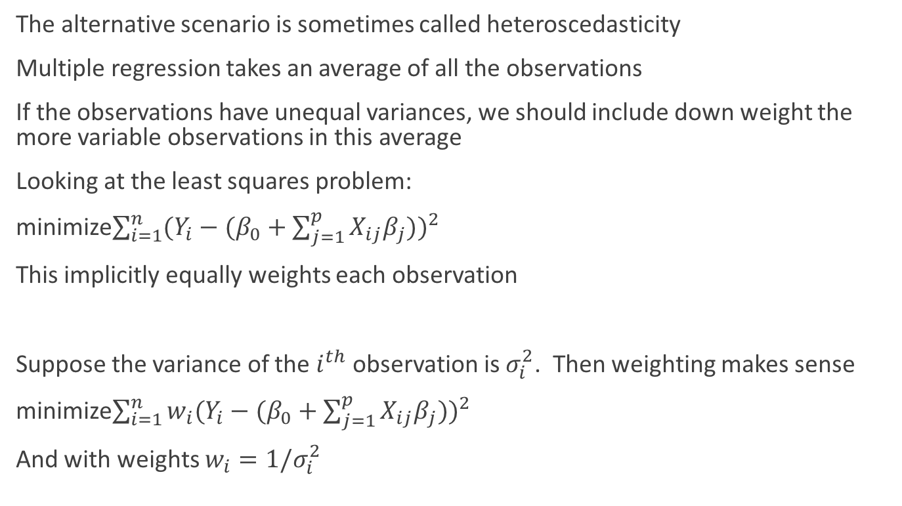
Weighted Regression
The alternative scenario is sometimes called heteroscedasticity
Multiple regression takes an average of all the observations
If the observations have unequal variances, we should include down weight the more variable observations in this average
Looking at the least squares problem:
minimize$\sum_{i=1}^{n}{{(Y_{i}−(β_{0}+\sum_{j=1}^{p}{X_{ij}β_{j}}))}^{2}}$
This implicitly equally weights each observation
Suppose the variance of the $i^{th}$ observation is $σ_{i}^{2}$. Then weighting makes sense
minimize$\sum_{i=1}^{n}{w_{i}{(Y_{i}−(β_{0}+\sum_{j=1}^{p}{X_{ij}β_{j}}))}^{2}}$
And with weights $w_{i}=1/σ_{i}^{2}$

Slide 36
Weighted Regression
Some typical scenarios when weighted regression is appropriate
The response is estimated and some reasonable standard errors are available
Example: In particle physics, highly sensitive detectors are used to make measurements. These detectors tend to come with estimates of the variability in the measurements
Responses themselves are averages and we know the total number of terms
Example: For privacy reasons, we can only get the total number of drug users in a school instead of whether particular students use drug
It is sensible that both 1) the variance is proportional to X and 2) the X,Y relationship is linear
Example: A person is counting grouse in a field (Y) and the time of day (X). As it gets darker out, the count might be more variable

Slide 37
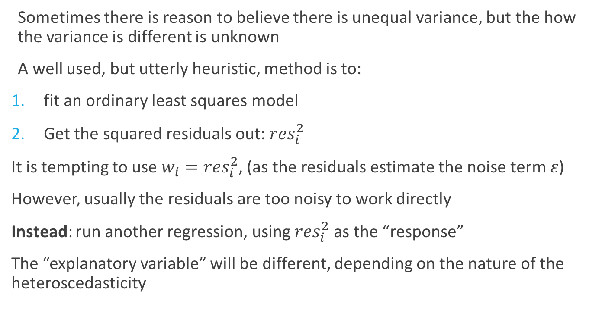
Weighted Regression: Estimating the Weights
Sometimes there is reason to believe there is unequal variance, but the how the variance is different is unknown
A well used, but utterly heuristic, method is to:
fit an ordinary least squares model
Get the squared residuals out: ${res}_{i}^{2}$
It is tempting to use $w_{i}={res}_{i}^{2}$, (as the residuals estimate the noise term $ε$)
However, usually the residuals are too noisy to work directly
Instead: run another regression, using ${res}_{i}^{2}$ as the “response”
The “explanatory variable” will be different, depending on the nature of the heteroscedasticity

Slide 38
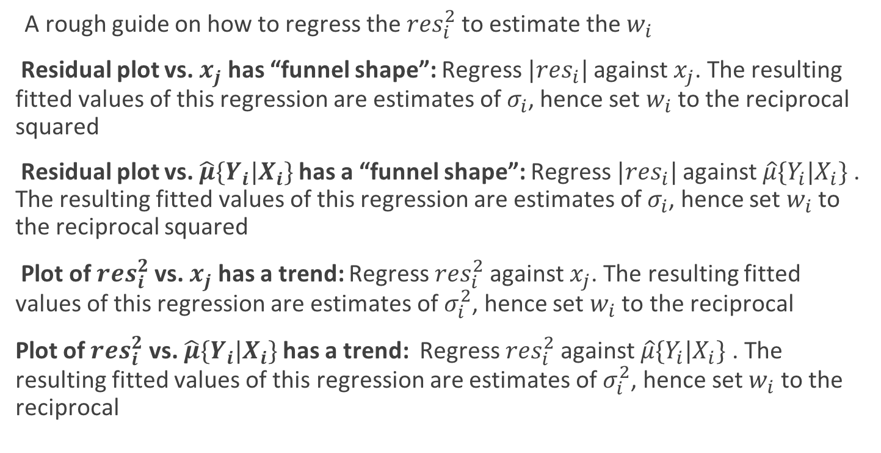
Weighted Regression: Estimating the Weights
A rough guide on how to regress the ${res}_{i}^{2}$ to estimate the $w_{i}$
Residual plot vs. $x_{j}$ has “funnel shape”: Regress $|{res}_{i}|$ against $x_{j}$. The resulting fitted values of this regression are estimates of $σ_{i}$, hence set $w_{i}$ to the reciprocal squared
Residual plot vs. $\hat{μ}\{Y_{i}|X_{i}\}$ has a “funnel shape”: Regress $|{res}_{i}|$ against $\hat{μ}\{Y_{i}|X_{i}\}$ . The resulting fitted values of this regression are estimates of $σ_{i}$, hence set $w_{i}$ to the reciprocal squared
Plot of ${res}_{i}^{2}$ vs. $x_{j}$ has a trend: Regress ${res}_{i}^{2}$ against $x_{j}$. The resulting fitted values of this regression are estimates of $σ_{i}^{2}$, hence set $w_{i}$ to the reciprocal
Plot of ${res}_{i}^{2}$ vs. $\hat{μ}\{Y_{i}|X_{i}\}$ has a trend: Regress ${res}_{i}^{2}$ against $\hat{μ}\{Y_{i}|X_{i}\}$ . The resulting fitted values of this regression are estimates of $σ_{i}^{2}$, hence set $w_{i}$ to the reciprocal

Slide 39
Nonlinear Regression

Slide 40
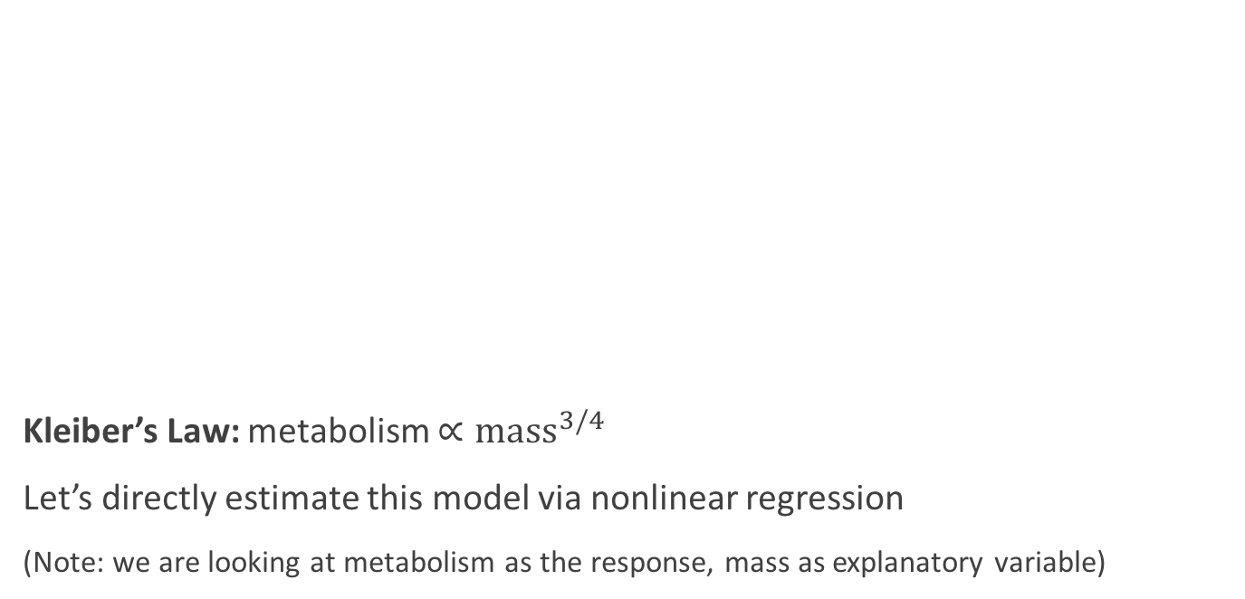
Returning to Kleiber’s Law
Kleiber’s Law: metabolism $∝{mass}^{3/4}$
Let’s directly estimate this model via nonlinear regression
(Note: we are looking at metabolism as the response, mass as explanatory variable)

Slide 41
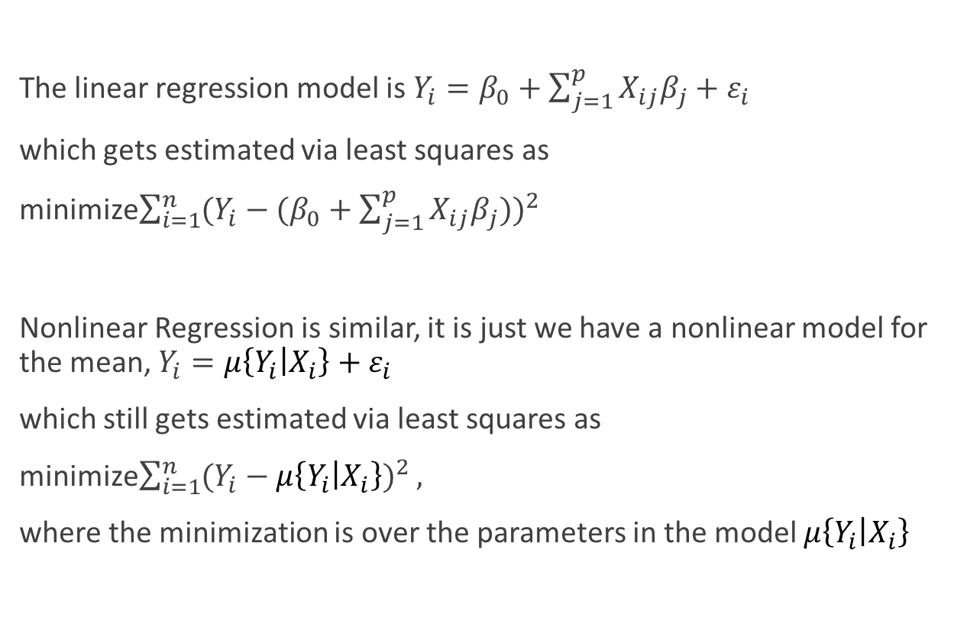
Nonlinear Regression
The linear regression model is $Y_{i}=β_{0}+\sum_{j=1}^{p}{X_{ij}β_{j}}+ε_{i}$
which gets estimated via least squares as
minimize$\sum_{i=1}^{n}{{(Y_{i}−(β_{0}+\sum_{j=1}^{p}{X_{ij}β_{j}}))}^{2}}$
Nonlinear Regression is similar, it is just we have a nonlinear model for the mean, $Y_{i}=μ\left\{Y_{i} | X_{i}\right\}+ε_{i}$
which still gets estimated via least squares as
minimize$\sum_{i=1}^{n}{{(Y_{i}−μ\left\{Y_{i} | X_{i}\right\})}^{2}},$
where the minimization is over the parameters in the model $μ\left\{Y_{i} | X_{i}\right\}$

Slide 42

Kleiber’s Law as a Nonlinear Regression
$Y_{i}=μ\left\{Y_{i} | X_{i}\right\}+ε_{i}=β_{0}+\sum_{j=1}^{p}{X_{i}β_{j}}+ε_{i}$
$Y_{i}=μ\left\{Y_{i} | X_{i}\right\}+ε_{i}$ = $β_{0}X_{i}^{β_{1}}+ε_{i}$
Kleiber’s Law posits that $β_{1}=3/4$ but it leaves $β_{0}$ unspecified
We can estimate this model in two ways, but they aren’t equivalent
$log\left(β_{0}X_{i}^{β_{1}}\right)= log\left(β_{0}\right)$+$β_{1}X_{i}→$ Attempt MLR:
$log\left(Y_{i}\right)=log\left(β_{0}\right)$+$β_{1}X_{i}+ε_{i}$
(We can test the “slope” of this model using MLR: $H_{0}:β_{1}=3/4$)
Or, we can directly fit the nonlinear model:
$Y_{i}=μ\left\{Y_{i} | X_{i}\right\}+ε_{i}$ = $β_{0}X_{i}^{β_{1}}+ε_{i}$
“log Y has linear mean with normal errors”
“Y has nonlinear mean with normal errors”

Slide 43



Kleiber’s Law as a Nonlinear Regression
Note the scales of metabolism and massExp have different scales
There is some indication that this particular model is reasonable

Slide 44


Nonlinear Regression
Nonlinear regressions do not necessarily have unique solutions and must be solved iteratively
Hence, the better starting values/grid you can provide, the better chance that you find a good solution

Slide 45

Nonlinear Regression
We can still look at residuals/leverage
There are more types of each, however
Here, we see at least one high leverage point and some mildly large studentized residuals

Slide 46


Nonlinear Regression

Slide 47


Nonlinear Regression

Slide 48


Nonlinear Regression: Limiting the Population

Slide 49


Nonlinear Regression: Limiting the Population
Conclusion: there is no evidence against the Kleiber’s Law hypothesized value
Also, we get an estimate for the proportionality constant: 437.5

Slide 50


Nonlinear Regression: Limiting the Population

